Slide 1
Kalix Demonstration
Event driven loan application system

Slide 2
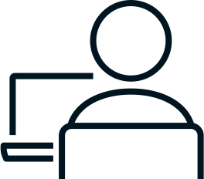





Event Driven Loan Application System
Reviewer
Submit
Submitted
Client
Loan Application
Loan Application
Processing
Approved Declined
Machine Learning
Approved Declined
Notification

Slide 3
Loan Application Service
Submit
Submitted
Approve/Decline
Loan Application
Service
Approved/Declined

Slide 4
Development Process
Define data structures (API endpoints & persistence)
Define state model
Code generation tool
Implement business logic
Unit & Integration test
Package & Deploy & Run in production
Test in production

Slide 5
Loan Application Service
Submitted
Loan Application
Processing
Loan Application
Service
Approved/Declined
Message Broker

Slide 6
Thank you!

